Slide 1

Kotlin 101 Basic Concepts

Slide 2
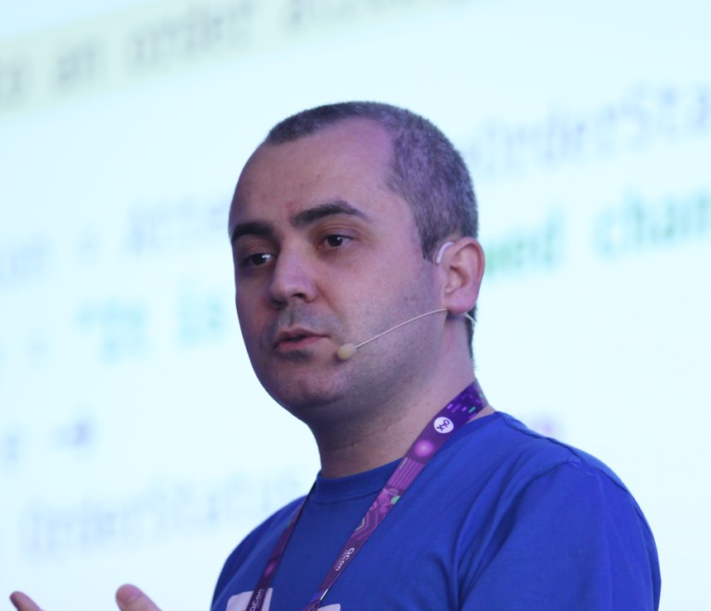
Hello
Augusto Branquinho
Github: bbranquinho
Email: augustobranquinho@gmail.com

Slide 3
1. Background
"Do I have to code in Java? Kotlin is easier!"

Slide 4

1. Background
Kotlin
Designed by
Java, Android, and Javascript
Native
Modern
Reduce the boilerplate
Kotlin in production: Google, N26, Pivotal, Uber, ...

Slide 5
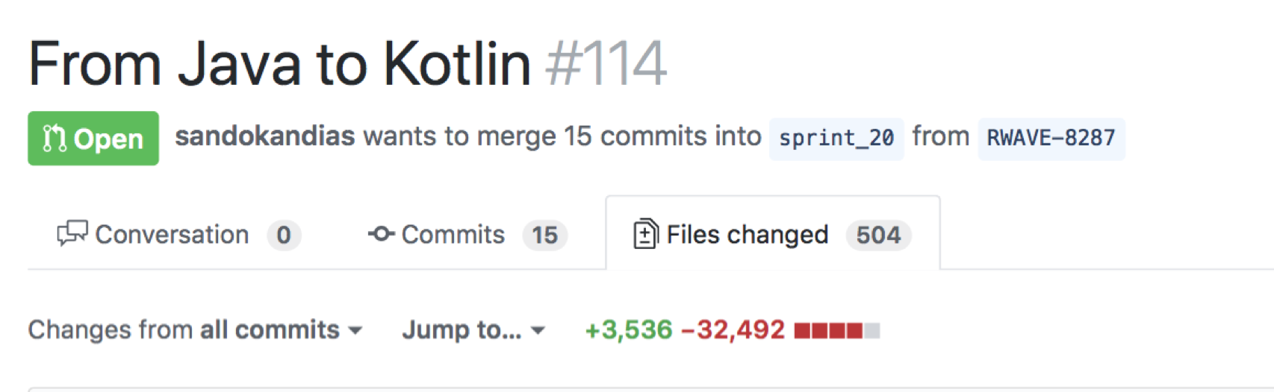

1. Background
Professional experience with Kotlin
2 years
Back-end projects
Microservices, Event Sourcing, CQRS, DDD, ...

Slide 6
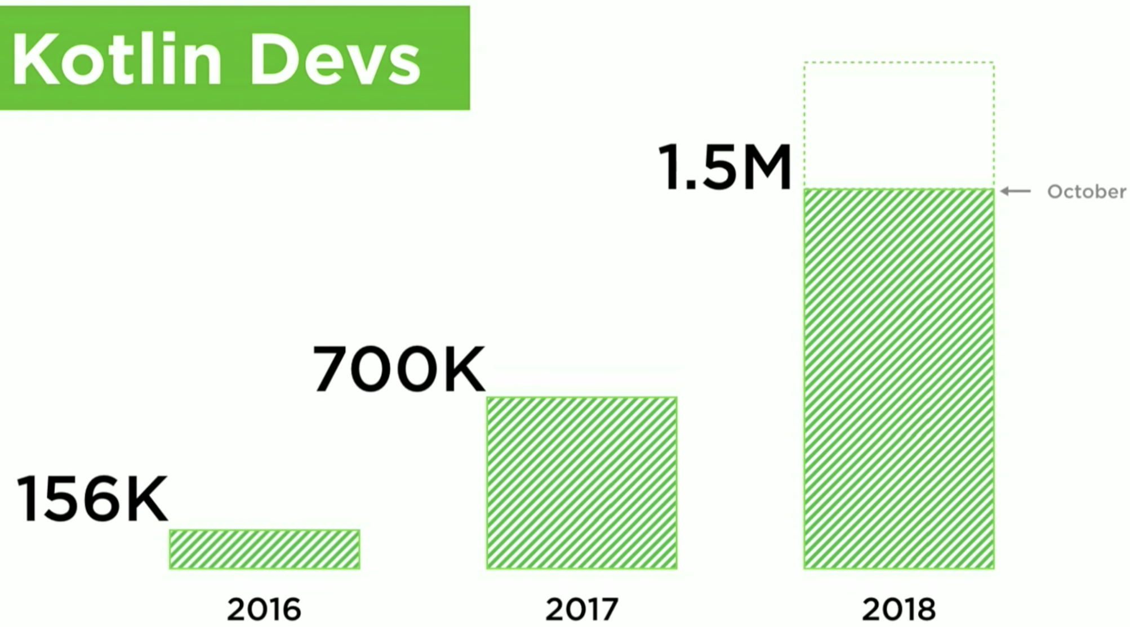
1. Background
Kotlin Conf 2018 by Andrey Breslav - https://www.youtube.com/watch?v=PsaFVLr8t4E

Slide 7
2. Benefits
“Readability, reuse, interoperability, safety, tooling.” Andrey Breslav – Kotlin Conf 2018

Slide 8
2. Benefits
Easy to learn
Fun to code
Used in production by many companies
Java Interoperability
Modern and clean
How Java can be improved?
New features (other languages)
Constant evolution
Multi-plataform

Slide 9

NULLs Everywhere

Slide 10

Kotlin is much safer than Java!

Slide 11

3. Challenges

Slide 12
3. Challenges
Teams speaking only Java
Interoperability
Old library based on Java
Order of Compilation
Specific Kotlin modules
Convince your company to try Kotlin

Slide 13
4. Basic Concepts

Slide 14


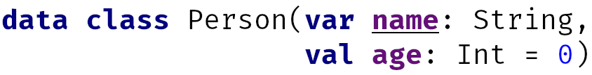
4.1. Class, Data Class and Object

Slide 15
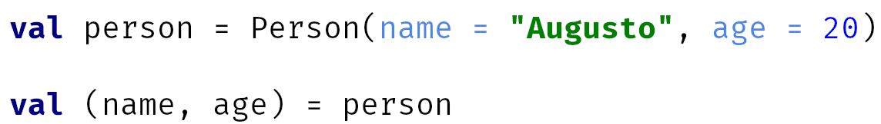
4.1. Class, Data Class and Object
Data class
Equals
ToString
HashCode
Copy
“Builder”
Destructuring Declarations

Slide 16
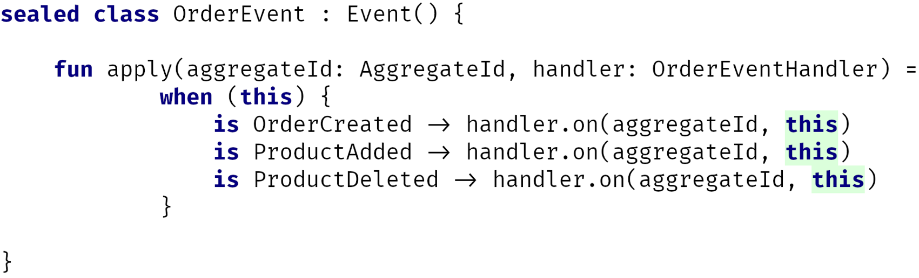
4.2. Sealed Class

Slide 17
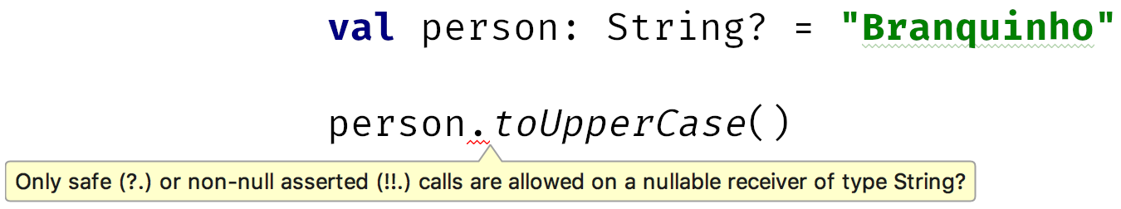
4.3. Null Safety

Slide 18
4.4. High Order Function
D
E

Slide 19
Conclusion
"Kotlin is beautiful!”

Slide 20

Conclusion
Try Kotlin

Slide 21
THANKS!
Any questions?
Github: bbranquinho
augustobranquinho@gmail.com

Slide 22
References
Kotlin Conf 2018- Keynote: https://www.youtube.com/watch?v=PsaFVLr8t4E
Foundation: http://kotl.in/foundation
Coroutines: http://kotl.in/coroutines
Kotlin Native: http://kotl.in/native
Multiplataform: http://kotl.in/multiplatform
Learn: http://kotl.in/learn

Slide 23
Credits
Special thanks to all the people who made and released these awesome resources for free:
Presentation template by SlidesCarnival
Photographs by Unsplash

